Slide 1
Unit 2: HTML & CSS:
WED DEVELOPMENT
3151606

Slide 2
What is HTML?
HTML stands for Hyper Text Markup Language
HTML is the standard markup language for creating Web pages
HTML describes the structure of a Web page
HTML consists of a series of elements
HTML elements tell the browser how to display the content
HTML elements label pieces of content such as "this is a heading", "this is a paragraph", "this is a link", etc.

Slide 3
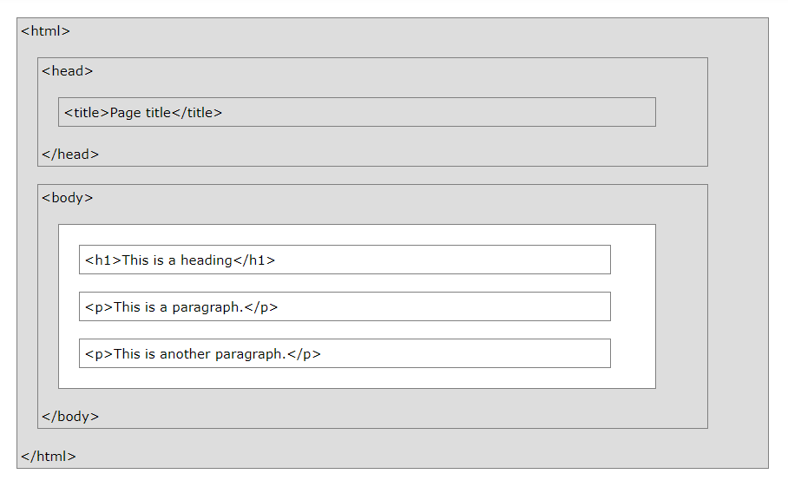
HTML Page Structure

Slide 4
A Simple HTML Document
<!DOCTYPE html> <html> <head> <title>Page Title</title> </head> <body> <h1>My First Heading</h1> <p>My first paragraph.</p> </body> </html>

Slide 5
Example Explained
The <!DOCTYPE html> declaration defines that this document is an HTML5 document
The <html> element is the root element of an HTML page
The <head> element contains meta information about the HTML page
The <title> element specifies a title for the HTML page (which is shown in the browser's title bar or in the page's tab)
The <body> element defines the document's body, and is a container for all the visible contents, such as headings, paragraphs, images, hyperlinks, tables, lists, etc.
The <h1> element defines a large heading
The <p> element defines a paragraph

Slide 6
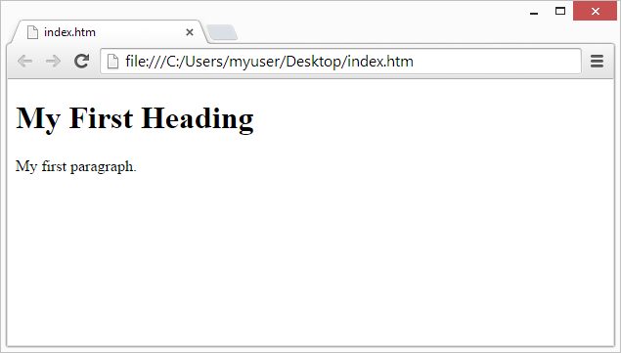
Web Browsers
The purpose of a web browser (Chrome, Edge, Firefox, Safari) is to read HTML documents and display them correctly.
A browser does not display the HTML tags, but uses them to determine how to display the document:

Slide 7
HTML Editors
Learn HTML Using Notepad or TextEdit
Web pages can be created and modified by using professional HTML editors.
However, for learning HTML we recommend a simple text editor like Notepad (PC) or TextEdit (Mac).
We believe in that using a simple text editor is a good way to learn HTML.
Follow the steps below to create your first web page with Notepad or TextEdit.

Slide 8
Step 1: Open Notepad (PC)
Windows 8 or later:
Open the Start Screen (the window symbol at the bottom left on your screen). Type Notepad.
Windows 7 or earlier:
Open Start > Programs > Accessories > Notepad

Slide 9
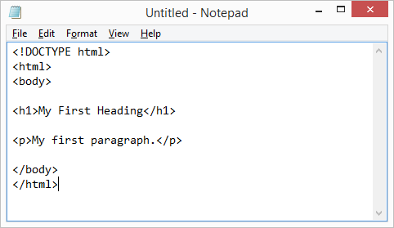
Step 2: Write Some HTML
<!DOCTYPE html> <html> <body> <h1>My First Heading</h1> <p>My first paragraph.</p> </body> </html>

Slide 10
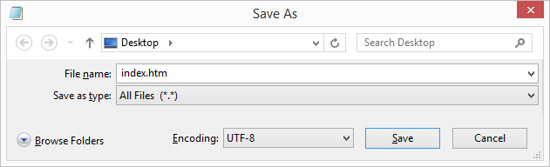
Step 3: Save the HTML Page
Save the file on your computer. Select File > Save as in the Notepad menu.
Name the file "index.htm" and set the encoding to UTF-8 (which is the preferred encoding for HTML files).

Slide 11

Step 4: View the HTML Page in Your Browser
Open the saved HTML file in your favorite browser (double click on the file, or right-click - and choose "Open with").
The result will look much like this:

Slide 12
HTML Elements
An HTML element is defined by a start tag, some content, and an end tag. <tagname>Content goes here...</tagname>
The HTML element is everything from the start tag to the end tag:
<h1>My First Heading</h1>
<p>My first paragraph.</p>

Slide 13
Nested HTML Elements
HTML elements can be nested (this means that elements can contain other elements).
All HTML documents consist of nested HTML elements.
The following example contains four HTML elements (<html>, <body>, <h1> and <p>):
<!DOCTYPE html> <html> <body> <h1>My First Heading</h1> <p>My first paragraph.</p> </body> </html>

Slide 14
To Remember
1. Never Skip the End Tag (e.g. <html> </html>
2. Empty HTML Elements (e.g <br>
3. HTML is Not Case Sensitive
4. HTML Tag Reference (Eg. H1 to h6: Define html headings)

Slide 15
HTML ATTRIBUTES
An HTML attribute provides additional information about an HTML element.
All HTML elements can have attributes
Attributes provide additional information about an element
Attributes are always specified in the start tag
Attributes usually come in name/value pairs like: name="value"

Slide 16
HTML links are defined with the <a> tag. The link address is specified in the href attribute:
<a href="https://www.w3schools.com">This is a link</a>
HTML images are defined with the <img> tag.
The filename of the image source is specified in the src attribute:
<img src="img_girl.jpg">
HTML images also have width and height attributes, which specifies the width and height of the image:
<img src="img_girl.jpg" width="500" height="600">

Slide 17
HTML PARAGRAPHS
The HTML <p> element defines a paragraph.
A paragraph always starts on a new line, and browsers automatically add some white space (a margin) before and after a paragraph.
EXAMPLE:
<p>This is a paragraph.</p> <p>This is another paragraph.</p>
<p> This paragraph contains a lot of lines in the source code, but the browser ignores it. </p>

Slide 18
HTML HEADING
HTML headings are titles or subtitles that you want to display on a webpage.
Heading 1
Heading 2
Heading 3
Heading 4
Heading 5
Heading 6

Slide 19
HTML headings are defined with the <h1> to <h6> tags.
<h1> defines the most important heading. <h6> defines the least important heading.
<h1>Heading 1</h1> <h2>Heading 2</h2> <h3>Heading 3</h3> <h4>Heading 4</h4> <h5>Heading 5</h5> <h6>Heading 6</h6>

Slide 20
BREAK RULE
The HTML <br> element defines a line break.
Use <br> if you want a line break (a new line) without starting a new paragraph:
<p>This is<br>a paragraph<br>with line breaks.</p>
The <br> tag is an empty tag, which means that it has no end tag.

Slide 21
HORIZONTAL RULES
The <hr> tag defines a thematic break in an HTML page, and is most often displayed as a horizontal rule.
The <hr> element is used to separate content (or define a change) in an HTML page:
<h1>This is heading 1</h1> <p>This is some text.</p> <hr> <h2>This is heading 2</h2> <p>This is some other text.</p> <hr>

Slide 22
COMMENTS
You can add comments to your HTML source by using the following syntax:
<!-- Write your comments here -->
Notice that there is an exclamation point (!) in the opening tag, but not in the closing tag
<!-- Do not display this image at the moment <img border="0" src="pic_trulli.jpg" alt="Trulli"> -->

Slide 23
HTML Formatting Elements
Formatting elements were designed to display special types of text:
<b> - Bold text
<strong> - Important text
<i> - Italic text
<em> - Emphasized text
<mark> - Marked text
<small> - Smaller text
<del> - Deleted text
<ins> - Inserted text
<sub> - Subscript text
<sup> - Superscript text

Slide 24
HTML <b> and <strong> Elements
The HTML <b> element defines bold text, without any extra importance.
<b>This text is bold</b>
The HTML <strong> element defines text with strong importance. The content inside is typically displayed in bold
<strong>This text is important!</strong>
HTML <i> and <em> Elements
The HTML <i> element defines a part of text in an alternate voice or mood. The content inside is typically displayed in italic.
<i>This text is italic</i>

Slide 25
The HTML <em> element defines emphasized text. The content inside is typically displayed in italic.
<em>This text is emphasized</em>
HTML <small> Element
The HTML <small> element defines smaller text
<small>This is some smaller text.</small>
HTML <mark> Element
The HTML <mark> element defines text that should be marked or highlighted:
<p>Do not forget to buy <mark>milk</mark> today.</p>

Slide 26
HTML <del> Element
The HTML <del> element defines text that has been deleted from a document. Browsers will usually strike a line through deleted text:
<p>My favorite color is <del>blue</del> red.</p>
HTML <ins> Element
The HTML <ins> element defines a text that has been inserted into a document. Browsers will usually underline inserted text:
<p>My favorite color is <del>blue</del> <ins>red</ins>.</p>

Slide 27
HTML <sub> Element
The HTML <sub> element defines subscript text. Subscript text appears half a character below the normal line, and is sometimes rendered in a smaller font. Subscript text can be used for chemical formulas, like H₂O.
<p>This is <sub>subscripted</sub> text.</p>
HTML <sup> Element
The HTML <sup> element defines superscript text. Superscript text appears half a character above the normal line, and is sometimes rendered in a smaller font. Superscript text can be used for footnotes, like WWW^{[1]}
<p>This is <sup>superscripted</sup> text.</p>

Slide 28
HTML Tables
HTML tables allow web developers to arrange data into rows and columns.
The <table> tag defines an HTML table.
Each table row is defined with a <tr> tag. Each table header is defined with a <th> tag. Each table data/cell is defined with a <td> tag.
By default, the text in <th> elements are bold and centered.
By default, the text in <td> elements are regular and left-aligned.

Slide 29
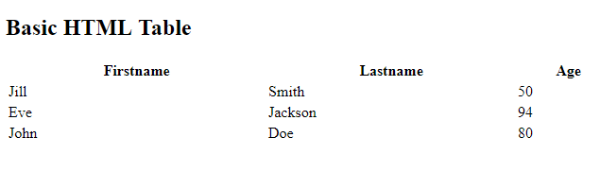
Table Example
<!DOCTYPE html>
<html>
<body>
<h2>Basic HTML Table</h2>
<table style="width:100%">
<tr>
<th>Firstname</th>
<th>Lastname</th>
<th>Age</th>
</tr>
<tr>
<td>Jill</td>
<td>Smith</td>
<td>50</td>
</tr>
<tr>
<td>Eve</td>
<td>Jackson</td>
<td>94</td>
</tr>
<tr>
<td>John</td>
<td>Doe</td>
<td>80</td>
</tr>
</table>
</body>
</html>

Slide 30
HTML Table – Column Span
To make a cell span more than one column, use the colspan attribute:
<table style="width:100%"> <tr> <th>Name</th> <th colspan="2">Telephone</th> </tr> <tr> <td>Bill Gates</td> <td>55577854</td> <td>55577855</td> </tr> </table>

Slide 31
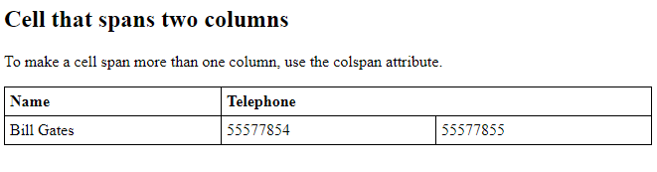
Colspan Example
<!DOCTYPE html>
<html>
<head>
<style>
table, th, td {
border: 1px solid black;
border-collapse: collapse;
}
th, td {
padding: 5px;
text-align: left;
}
</style>
</head>
<body>
<h2>Cell that spans two columns</h2>
<p>To make a cell span more than one column, use the colspan attribute.</p>
<table style="width:100%">
<tr>
<th>Name</th>
<th colspan="2">Telephone</th>
</tr>
<tr>
<td>Bill Gates</td>
<td>55577854</td>
<td>55577855</td>
</tr>
</table>
</body>
</html>

Slide 32
HTML Table – Row Span
To make a cell span more than one row, use the rowspan attribute:
<table style="width:100%"> <tr> <th>Name:</th> <td>Bill Gates</td> </tr> <tr> <th rowspan="2">Telephone:</th> <td>55577854</td> </tr> <tr> <td>55577855</td> </tr> </table>

Slide 33
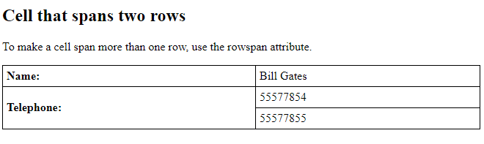
Rowspan Example
<!DOCTYPE html>
<html>
<head>
<style>
table, th, td {
border: 1px solid black;
border-collapse: collapse;
}
th, td {
padding: 5px;
text-align: left;
}
</style>
</head>
<body>
<h2>Cell that spans two rows</h2>
<p>To make a cell span more than one row, use the rowspan attribute.</p>
<table style="width:100%">
<tr>
<th>Name:</th>
<td>Bill Gates</td>
</tr>
<tr>
<th rowspan="2">Telephone:</th>
<td>55577854</td>
</tr>
<tr>
<td>55577855</td>
</tr>
</table>
</body>
</html>

Slide 34
HTML Links
Links are found in nearly all web pages. Links allow users to click their way from page to page.
HTML links are hyperlinks.
You can click on a link and jump to another document.
When you move the mouse over a link, the mouse arrow will turn into a little hand.
<a href="url">link text</a>

Slide 35
The most important attribute of the <a> element is the href attribute, which indicates the link's destination.
The link text is the part that will be visible to the reader.
Clicking on the link text, will send the reader to the specified URL address.
<a href="https://www.google.com/">Visit GOOGLE Link</a>
By default, links will appear as follows in all browsers:
An unvisited link is underlined and blue
A visited link is underlined and purple
An active link is underlined and red

Slide 36
Example of Link
<html>
<body>
<h1>HTML Links</h1>
<p><a href="https://www.google.com/">Visit google site, click here!</a></p>
</body>
</html>

Slide 37
HTML Links - The target Attribute
By default, the linked page will be displayed in the current browser window. To change this, you must specify another target for the link.
The target attribute specifies where to open the linked document.
The target attribute can have one of the following values:
_self – Default - Opens the document in the same window/tab as it was clicked
_blank - Opens the document in a new window or tab
_parent - Opens the document in the parent frame
_top - Opens the document in the full body of the window

Slide 38
Target Example
<html>
<body>
<h2>The target Attribute</h2>
<a href="https://www.google.com/" target="_blank"> Visit google site, click here!</a>
<p>If target="_blank", the link will open in a new browser window or tab.</p>
</body>
</html>

Slide 39
Absolute URLs vs. Relative URLs
Both examples above are using an absolute URL (a full web address) in the href attribute.
A local link (a link to a page within the same website) is specified with a relative URL (without the "https://www" part):
<h2>Absolute URLs</h2> <p><a href="https://www.w3.org/">W3C</a></p> <p><a href="https://www.google.com/">Google</a></p> <h2>Relative URLs</h2> <p><a href="html_images.asp">HTML Images</a></p> <p><a href="/css/default.asp">CSS Tutorial</a></p>

Slide 40
HTML Links - Use an Image as a Link
To use an image as a link, just put the <img> tag inside the <a> tag:
<a href="default.asp"> <img src="smiley.gif" alt="HTML tutorial" style="width:42px;height:42px;"> </a>
Link Titles attribute:
<a href="https://www.google.com/" title="Go to Google website">Visit google website</a>

Slide 41
HTML Images
Images can improve the design and the appearance of a web page.
<img src="pic_trulli.jpg" alt="Italian Trulli">
<html>
<body>
<h2>HTML Image</h2>
<img src="pic_trulli.jpg" alt="Trulli" width="500" height="333">
</body>
</html>

Slide 42
The HTML <img> tag is used to embed an image in a web page.
Images are not technically inserted into a web page; images are linked to web pages. The <img> tag creates a holding space for the referenced image.
The <img> tag is empty, it contains attributes only, and does not have a closing tag.
The <img> tag has two required attributes:
src - Specifies the path to the image
alt - Specifies an alternate text for the image

Slide 43
The src Attribute
The required src attribute specifies the path (URL) to the image.
Note: When a web page loads; it is the browser, at that moment, that gets the image from a web server and inserts it into the page. Therefore, make sure that the image actually stay in the same spot in relation to the web page, otherwise your visitors will get a broken link icon. The broken link icon is shown if the browser cannot find the image.

Slide 44
Image Size - Width and Height
<img src="img_girl.jpg" alt="Girl in a jacket" width="500" height="600">
Image as a Link
<a href="default.asp"> <img src="smiley.gif" alt="HTML tutorial" style="width:42px;height:42px;"> </a>

Slide 45
HTML <meta> Tag
<head> <meta charset="UTF-8"> <meta name="description" content="Free Web tutorials"> <meta name="keywords" content="HTML, CSS, JavaScript"> <meta name="author" content="John Doe"> <meta name="viewport" content="width=device-width, initial-scale=1.0"> </head>

Slide 46
The <meta> tag defines metadata about an HTML document. Metadata is data (information) about data.
<meta> tags always go inside the <head> element, and are typically used to specify character set, page description, keywords, author of the document, and viewport settings.
Metadata will not be displayed on the page, but is machine parsable.
Metadata is used by browsers (how to display content or reload page), search engines (keywords), and other web services.
There is a method to let web designers take control over the viewport (the user's visible area of a web page), through the <meta> tag (See "Setting The Viewport" example below).

Slide 47
HTML Lists
HTML lists allow web developers to group a set of related items in lists.
An unordered HTML list:
Item
Item
Item
Item
An ordered HTML list:
First item
Second item
Third item
Fourth item

Slide 48
Unordered HTML List
An unordered list starts with the <ul> tag. Each list item starts with the <li> tag.
The list items will be marked with bullets (small black circles) by default:
<ul> <li>Coffee</li> <li>Tea</li> <li>Milk</li> </ul>

Slide 49
Ordered HTML List
An ordered list starts with the <ol> tag. Each list item starts with the <li> tag.
The list items will be marked with numbers by default:
<ol> <li>Coffee</li> <li>Tea</li> <li>Milk</li> </ol>

Slide 50
HTML Description Lists
HTML also supports description lists.
A description list is a list of terms, with a description of each term.
The <dl> tag defines the description list, the <dt> tag defines the term (name), and the <dd> tag describes each term:
<dl> <dt>Coffee</dt> <dd>- black hot drink</dd> <dt>Milk</dt> <dd>- white cold drink</dd> </dl>

Slide 51
Html Color
There are 3 different methods to set color:
Using color name:
< body bgcolor=“red”>
<font color=“green”>
B) Using RGB(Red,Green,Blue) Values:
<body bgcolor=“rgb(72,0,0)”>
<font color=“rgb(34,52,23)”>
c) Using Hexadecimal Value:
<body bgcolor=“#ffff00”>
<font color=“#ff0000”>

Slide 52
Html Font
Font Size:
<font size=“10”>Here font size is 10</font>
Font Color:
<font color=“red”> Here font size is red</font>
Font Face:
<font face=“Times New Roman”>Here font style is times new roman</font>

Slide 53
HTML <frame> Tag
<frameset cols=“25%”, *,”25%”>
<frame src=“a.html”>
<frame src=“b.html”>
<frame src=“c.html”>
</frameset>

Slide 54
The <frame> tag is not supported in HTML5 instead <iframe> tag is used in it.
Frame has attributes like border, marginheight, marginwidth nosize, scrolling, src.
Fro example:
<frame border=“1”> if set 0 then no border will display.
<frame marginheight=“20px”> displays height in pixel format.
<frame marginwidth=“20px”> displays width in pixel format.
<frame nosize>
<frame scrolling=“yes”> options available are yes, no, auto.
<frame src=“xyz.html”> shows the path to other webpage into frame.

Slide 55
The <frameset> tag defines a frameset and holds one or more frame within from separate document.
The frameset specifies how many rows/column will be in the frameset and in which format percentage/pixel format.
<frameset cols=“50%,50%”>
<frameset rows=“50%,25%,25%”>

Slide 56
HTML <iframe> Tag
The <iframe> tag specifies an inline frame.
<iframe src="https://www.google.com" title=“Free Online Web Tutorials"></iframe>

Slide 57
Attribute | Value | Description
allow |  | Specifies a feature policy for the <iframe>
allowfullscreen | true false | Set to true if the <iframe> can activate fullscreen mode by calling the requestFullscreen() method
allowpaymentrequest | true false | Set to true if a cross-origin <iframe> should be allowed to invoke the Payment Request API
height | pixels | Specifies the height of an <iframe>. Default height is 150 pixels
name | text | Specifies the name of an <iframe>
referrerpolicy | no-referrer no-referrer-when-downgrade origin origin-when-cross-origin same-origin strict-origin strict-origin-when-cross-origin unsafe-url | Specifies how much/which referrer information that will be sent when processing the iframe attributes
sandbox | allow-forms allow-pointer-lock allow-popups allow-same-origin allow-scripts allow-top-navigation | Enables an extra set of restrictions for the content in an <iframe>
src | URL | Specifies the address of the document to embed in the <iframe>
srcdoc | HTML_code | Specifies the HTML content of the page to show in the <iframe>
width | pixels | Specifies the width of an <iframe>. Default width is 300 pixels

Slide 58
HTML Form Tag
An HTML form is used to collect user input. The user input can then be sent to a server for processing.
<form action="/action_page.php">
<label for="fname">First name:</label><br>
<input type="text" id="fname" name="fname" value="John"><br>
<label for="lname">Last name:</label><br>
<input type="text" id="lname" name="lname" value="Doe"><br><br>
<input type="submit" value="Submit">
</form>

Slide 59
The <form> Element
The HTML <form> element is used to create an HTML form for user input:
<form> . form elements . </form>
Form elements are different types of input elements, like: text fields, checkboxes, radio buttons, submit buttons, and more.

Slide 60
The <input> Element
The <input> element is the most important form element.
An <input> element can be displayed in many ways, depending on the type attribute.
Text Fields
<form> <label for="fname">First name:</label><br> <input type="text" id="fname" name="fname"><br> <label for="lname">Last name:</label><br> <input type="text" id="lname" name="lname"> </form>

Slide 61
The <label> Element
Notice the use of the <label> element in the example above.
The <label> tag defines a label for many form elements.
The <label> element is useful for screen-reader users, because the screen-reader will read out loud the label when the user is focused on the input element.
The <label> element also help users who have difficulty clicking on very small regions (such as radio buttons or checkboxes) - because when the user clicks the text within the <label> element, it toggles the radio button/checkbox.
The for attribute of the <label> tag should be equal to the id attribute of the <input> element to bind them together.

Slide 62
Radio Buttons
<input type="radio"> defines a radio button.
Radio buttons let a user select ONE of a limited number of choices.
<form> <input type="radio" id="male" name="gender" value="male"> <label for="male">Male</label><br> <input type="radio" id="female" name="gender" value="female"> <label for="female">Female</label><br> <input type="radio" id="other" name="gender" value="other"> <label for="other">Other</label> </form>

Slide 63
The Submit Button
<input type="submit"> defines a button for submitting the form data to a form-handler.
The form-handler is typically a page on the server with a script for processing input data.
The form-handler is specified in the form's action attribute.
<form action="/action_page.php"> <label for="fname">First name:</label><br> <input type="text" id="fname" name="fname" value="John"><br> <label for="lname">Last name:</label><br> <input type="text" id="lname" name="lname" value="Doe"><br><br> <input type="submit" value="Submit"> </form>

Slide 64
The Action Attribute
The action attribute defines the action to be performed when the form is submitted.
Usually, the form data is sent to a page on the server when the user clicks on the submit button.
In the example above, the form data is sent to a page on the server called "/action_page.php". This page contains a server-side script that handles the form data:
<form action="/action_page.php">

Slide 65
The Target Attribute
The target attribute specifies if the submitted result will open in a new browser tab, a frame, or in the current window.
The default value is "_self" which means the form will be submitted in the current window.
To make the form result open in a new browser tab, use the value "_blank".
<form action="/action_page.php" target="_blank">

Slide 66
The Method Attribute
The method attribute specifies the HTTP method (GET or POST) to be used when submitting the form data.
<form action="/action_page.php" method="get">
<form action="/action_page.php" method="post">

Slide 67
The Name Attribute
Each input field must have a name attribute to be submitted.
If the name attribute is omitted, the data of that input field will not be sent at all.
<form action="/action_page.php"> <label for="fname">First name:</label><br> <input type="text" id="fname" value="John"><br><br> <input type="submit" value="Submit"> </form>

Slide 68
The HTML <form> Elements
The <form> element can contain one or more of the following form elements:
<label>
<input>
<select>
<textarea>
<button>
<fieldset>
<legend>
<datalist>
<output>
<option>
<optgroup>

Slide 69
The <select> Element
The <select> element defines a drop-down list:
<label for="cars">Choose a car:</label> <select id="cars" name="cars"> <option value="volvo">Volvo</option> <option value="saab">Saab</option> <option value="fiat">Fiat</option> <option value="audi">Audi</option> </select>
The <option> elements defines an option that can be selected.
By default, the first item in the drop-down list is selected.
To define a pre-selected option, add the selected attribute to the option:

Slide 70
The <textarea> Element
The <textarea> element defines a multi-line input field (a text area):
<textarea name="message" rows="10" cols="30"> The cat was playing in the garden. </textarea>

Slide 71
The <button> Element
The <button> element defines a clickable button:
<button type="button" onclick="alert('Hello World!')">Click Me!</button>

Slide 72
The <fieldset> and <legend> Elements
The <fieldset> element is used to group related data in a form.
The <legend> element defines a caption for the <fieldset> element.
<fieldset> <legend>Personalia:</legend> <label for="fname">First name:</label><br> <input type="text" id="fname" name="fname" value="John"><br> <label for="lname">Last name:</label><br> <input type="text" id="lname" name="lname" value="Doe"><br><br> <input type="submit" value="Submit"> </fieldset>

Slide 73
The <datalist> Element
The <datalist> element specifies a list of pre-defined options for an <input> element.
Users will see a drop-down list of the pre-defined options as they input data.
The list attribute of the <input> element, must refer to the id attribute of the <datalist> element.
<input list="browsers"> <datalist id="browsers"> <option value="Internet Explorer"> <option value="Firefox"> <option value="Chrome"> <option value="Opera"> <option value="Safari"> </datalist>

Slide 74
HTML Input Types
<input type="button">
<input type="checkbox">
<input type="color">
<input type="date">
<input type="datetime-local">
<input type="email">
<input type="file">
<input type="hidden">
<input type="image">
<input type="number">
<input type="month">
<input type="password">
<input type="radio">
<input type="range">
<input type="reset">
<input type="search">
<input type="submit">
<input type="tel">
<input type="text">
<input type="time">
<input type="url">
<input type="week">

Slide 75
Input Type Password
<label for="pwd">Password:</label><br> <input type="password" id="pwd" name="pwd">
Input Type Reset
<input type="reset">
Input Type Checkbox
<form> <input type="checkbox" id="vehicle1" name="vehicle1" value="Bike"> <label for="vehicle1"> I have a bike</label><br> <input type="checkbox" id="vehicle2" name="vehicle2" value="Car"> <label for="vehicle2"> I have a car</label><br> <input type="checkbox" id="vehicle3" name="vehicle3" value="Boat"> <label for="vehicle3"> I have a boat</label> </form>

Slide 76
Input Type Color
<form> <label for="favcolor">Select your favorite color:</label> <input type="color" id="favcolor" name="favcolor"> </form>
Input Type Date
<form> <label for="birthday">Birthday:</label> <input type="date" id="birthday" name="birthday"> </form>
Input Type Datetime-local
<form> <label for="birthdaytime">Birthday (date and time):</label> <input type="datetime-local" id="birthdaytime" name="birthdaytime"> </form>

Slide 77
Input Type Email
The <input type="email"> is used for input fields that should contain an e-mail address.
Depending on browser support, the e-mail address can be automatically validated when submitted.
Some smartphones recognize the email type, and add ".com" to the keyboard to match email input.
<form> <label for="email">Enter your email:</label> <input type="email" id="email" name="email"> </form>

Slide 78
Input Type File
The <input type="file"> defines a file-select field and a "Browse" button for file uploads.
<form> <label for="myfile">Select a file:</label> <input type="file" id="myfile" name="myfile"> </form>
Input Type Month
The <input type="month"> allows the user to select a month and year.
Depending on browser support, a date picker can show up in the input field.
<label for="bdaymonth">Birthday (month and year):</label> <input type="month" id="bdaymonth" name="bdaymonth">

Slide 79
Input Type Number
The <input type="number"> defines a numeric input field.
You can also set restrictions on what numbers are accepted.
<form> <label for="quantity">Quantity (between 1 and 5):</label> <input type="number" id="quantity" name="quantity" min="1" max="5"> </form>
Input Type Range
The <input type="range"> defines a control for entering a number whose exact value is not important (like a slider control). Default range is 0 to 100. However, you can set restrictions on what numbers are accepted with the min, max, and step attributes:
<form> <label for="vol">Volume (between 0 and 50):</label> <input type="range" id="vol" name="vol" min="0" max="50"> </form>

Slide 80
Input Type Search
The <input type="search"> is used for search fields (a search field behaves like a regular text field).
<form> <label for="gsearch">Search Google:</label> <input type="search" id="gsearch" name="gsearch"> </form>
Input Type Tel
The <input type="tel"> is used for input fields that should contain a telephone number.
<form> <label for="phone">Enter your phone number:</label> <input type="tel" id="phone" name="phone" pattern="[0-9]{3}-[0-9]{2}-[0-9]{3}"> </form>

Slide 81
Input Type Time
The <input type="time"> allows the user to select a time (no time zone).
Depending on browser support, a time picker can show up in the input field.
<form> <label for="appt">Select a time:</label> <input type="time" id="appt" name="appt"> </form>
Input Type Url
The <input type="url"> is used for input fields that should contain a URL address.
Depending on browser support, the url field can be automatically validated when submitted.
Some smartphones recognize the url type, and adds ".com" to the keyboard to match url input.
<label for="homepage">Add your homepage:</label> <input type="url" id="homepage" name="homepage">

Slide 82
Input Type Week
The <input type="week"> allows the user to select a week and year.
Depending on browser support, a date picker can show up in the input field.
<label for="week">Select a week:</label> <input type="week" id="week" name="week">

Slide 83
HTML Input Attributes
The value Attribute
<form> <label for="fname">First name:</label><br> <input type="text" id="fname" name="fname" value="John"><br> <label for="lname">Last name:</label><br> <input type="text" id="lname" name="lname" value="Doe"> </form>
The readonly Attribute
The input readonly attribute specifies that an input field is read-only.

Slide 84
<form> <label for="fname">First name:</label><br> <input type="text" id="fname" name="fname" value="John" readonly><br> <label for="lname">Last name:</label><br> <input type="text" id="lname" name="lname" value="Doe"> </form>
The disabled Attribute
The input disabled attribute specifies that an input field should be disabled.
A disabled input field is unusable and un-clickable.
<form> <label for="fname">First name:</label><br> <input type="text" id="fname" name="fname" value="John" disabled><br> <label for="lname">Last name:</label><br> <input type="text" id="lname" name="lname" value="Doe"> </form>

Slide 85
The size Attribute
The input size attribute specifies the visible width, in characters, of an input field.
The default value for size is 20.
<form> <label for="fname">First name:</label><br> <input type="text" id="fname" name="fname" size="50"><br> <label for="pin">PIN:</label><br> <input type="text" id="pin" name="pin" size="4"> </form>

Slide 86
The maxlength Attribute
The input maxlength attribute specifies the maximum number of characters allowed in an input field.
<form> <label for="fname">First name:</label><br> <input type="text" id="fname" name="fname" size="50"><br> <label for="pin">PIN:</label><br> <input type="text" id="pin" name="pin" maxlength="4" size="4"> </form>

